Slide 1
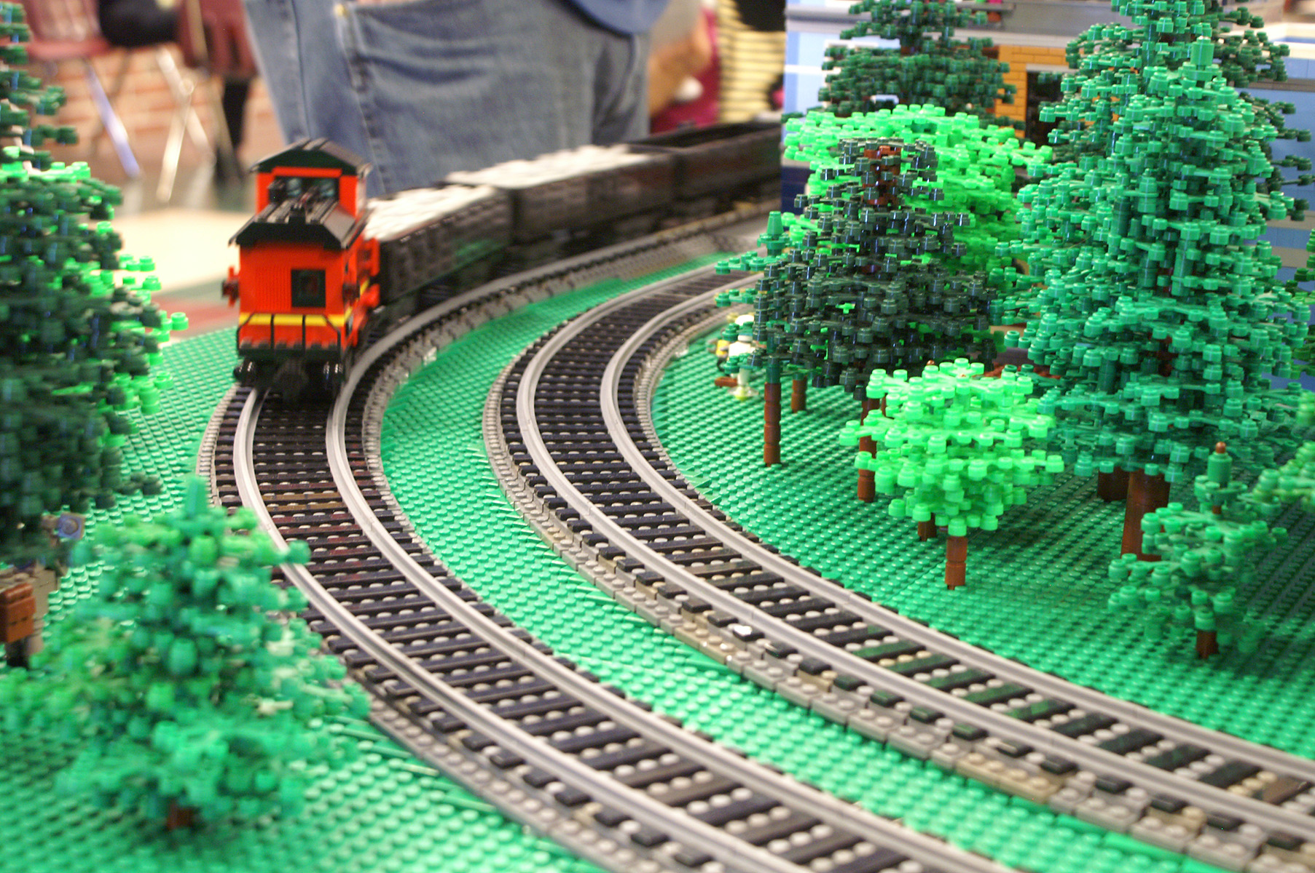
Modeling with ME Models Track
Presented by
Tony Sava

Slide 2
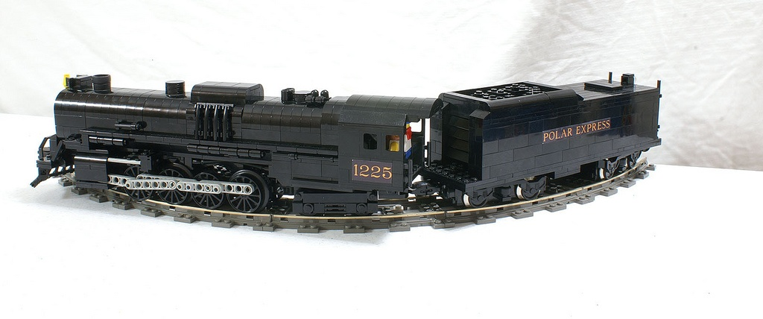
Current LEGO Track Options
Standard Curves
Unrealistically tight radius
Slower speeds to prevent derailment
Difficult to articulate larger engines
Large overhangs

Slide 3
Standard Track

Slide 4
Current LEGO Track Options
Smooth or “Grand” Curves
~23 pieces of straight track to make one curve
Realistic Radius
Possible to run full throttle with little risk
Minimal articulation
HUGE!
Unarticulated steam engines “wiggle” in Grand Curves

Slide 5
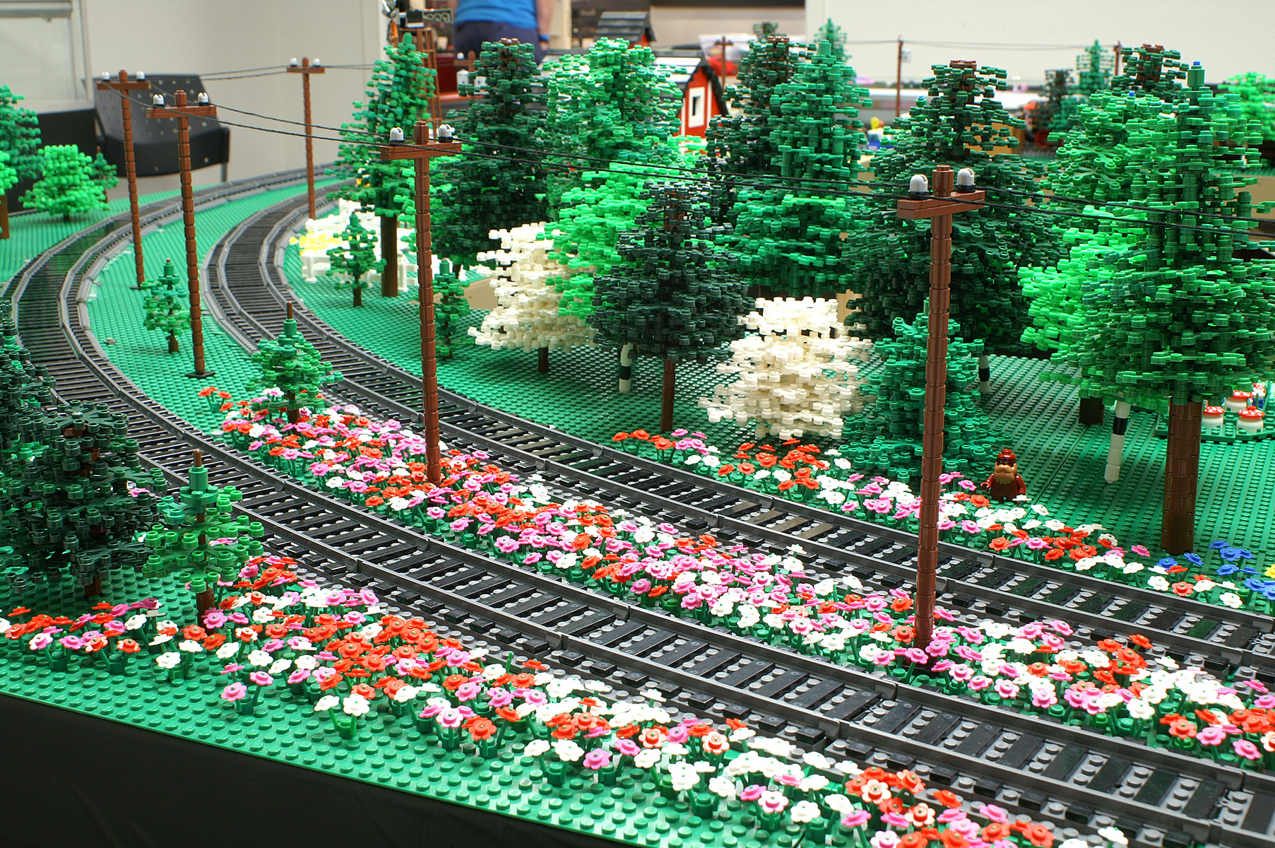
Grand Curves

Slide 6
Grand Curves

Slide 7
ME Models Track Overview
Plastic Track
Straight Track
½ length
Full Length
Double Length
Curved Track
R56
R72
R88
R104

Slide 8
ME Models Track Overview
Metal Track
9v compatible
Straight Track
½ length
Full Length
Double Length
Curved Track
R56

Slide 9
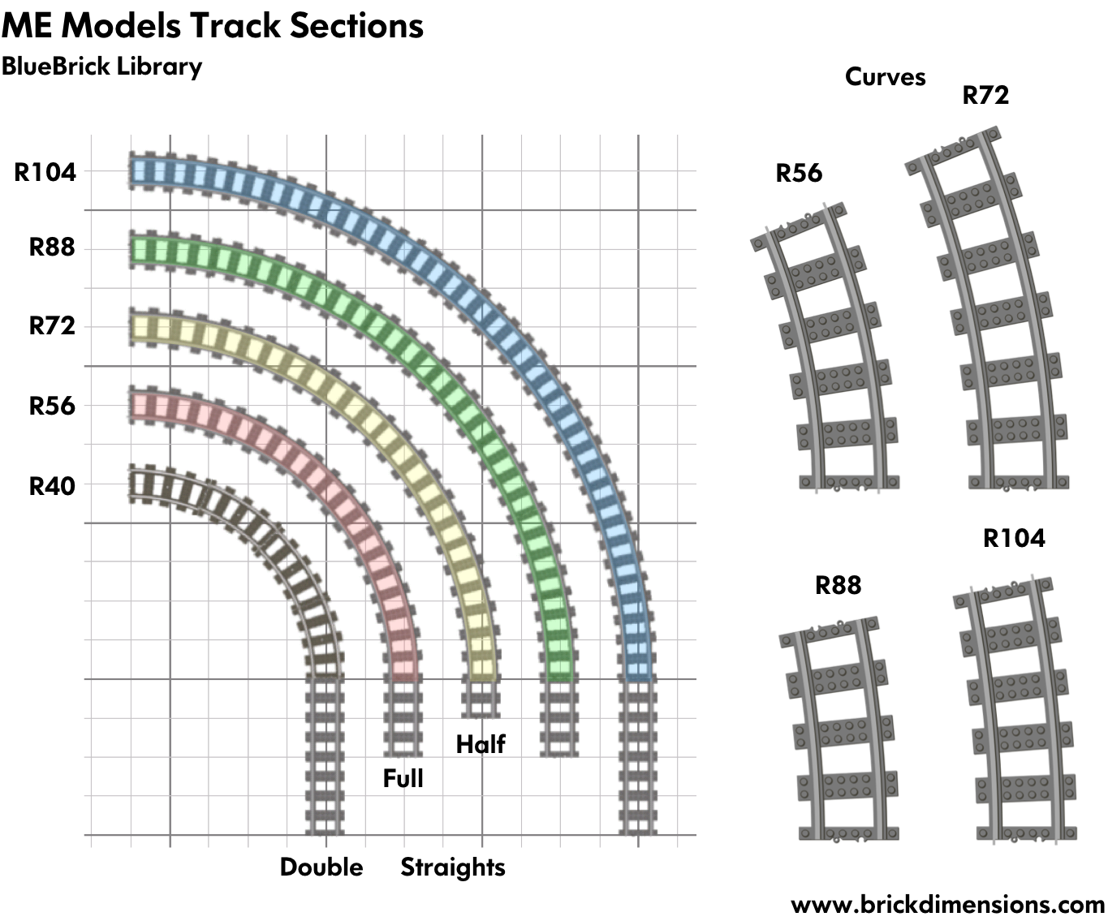
ME Models Track Overview
Credit : Michael Gale

Slide 10
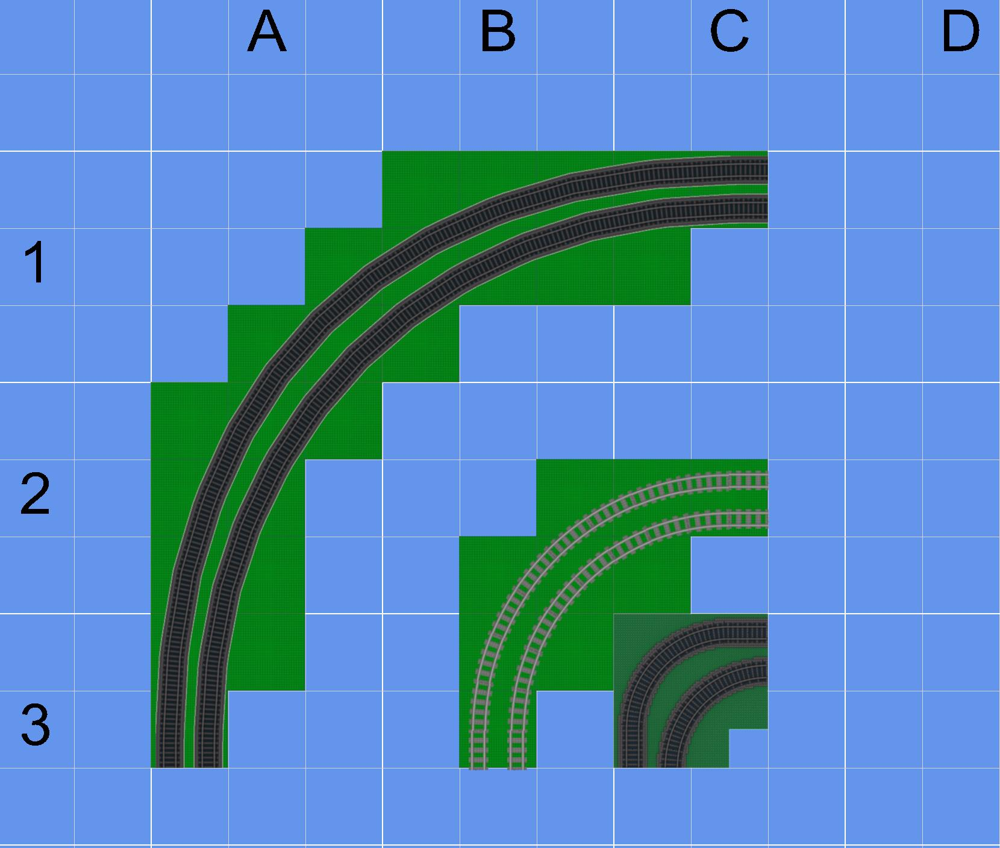
Using ME Models Track

Slide 11
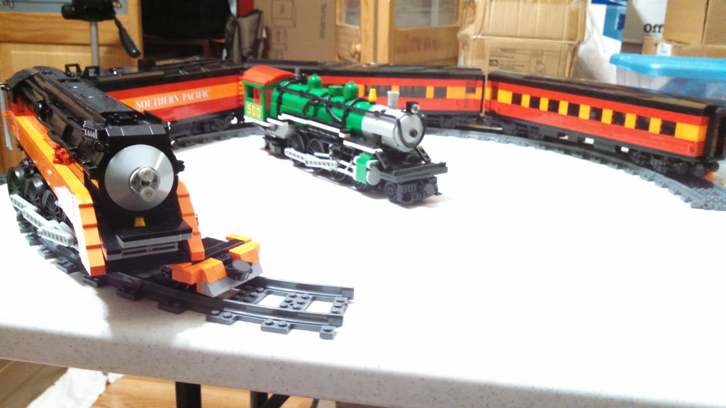
ME Models Track Overview

Slide 12
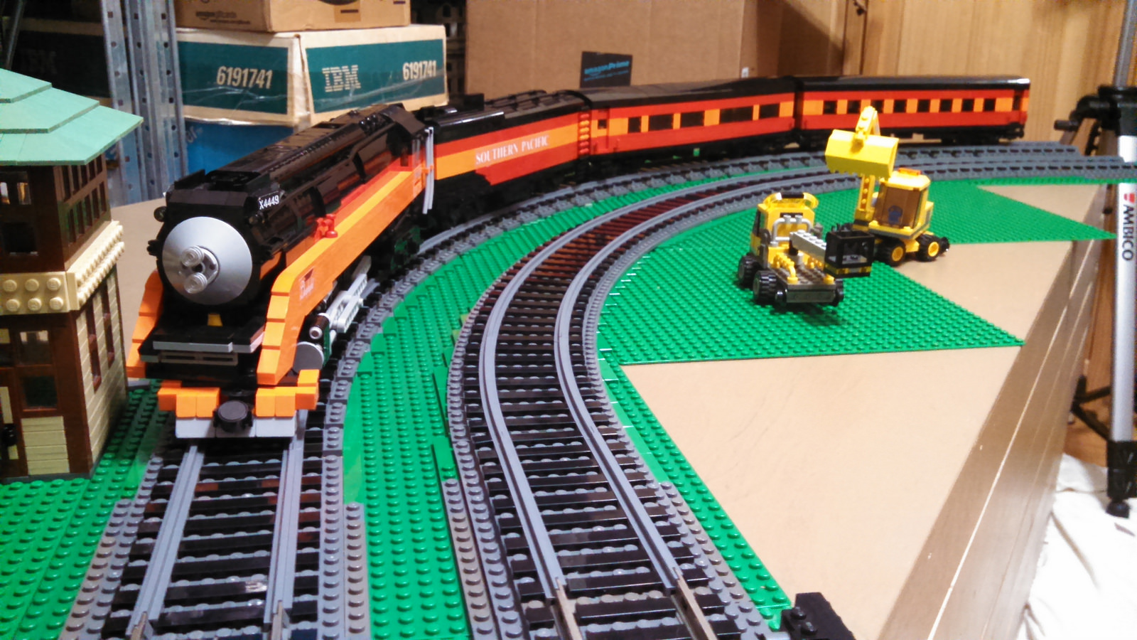
ME Models Track Overview

Slide 13
ME Models Track Overview
Colors
Ties
Dark Grey
Brown
Dark Brown
Plastic Rails
Dark Grey

Slide 14
ME Models Track Overview
Colors
Ties
Dark Grey
Brown
Dark Brown
Plastic Rails
Dark Grey
SILVER!

Slide 15
ME Models Track Overview
Price (Plastic)
Straights
½ Length - $11 – 8 sections
Full Length - $20 – 10 sections
Double length - $14 – 4 sections
Curves (makes half circle)
R56 - $19 – 8 Sections
R72 - $22 – 8 Sections
R88 - $29 – 16 Sections
R104 - $34 – 16 Sections

Slide 16
ME Models Track Performance
Texas Brick Railroad has fielded ME Models curves at two shows running high speed 8-wide and ultra-weight 10-wide trains.
No incidents involving ME Models Rails
Track stayed in place
Track did not “pop” free or disassemble
Trains slowed in standard curves, accelerated in ME curves

Slide 17
ME Models Track Performance

Slide 18
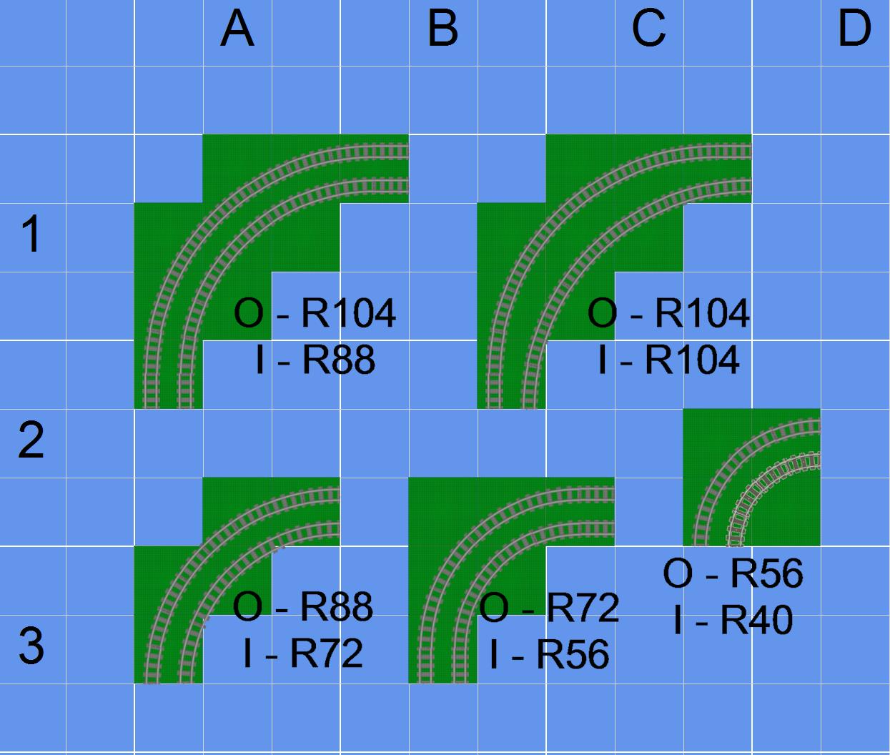
Using ME Models Track

Slide 19
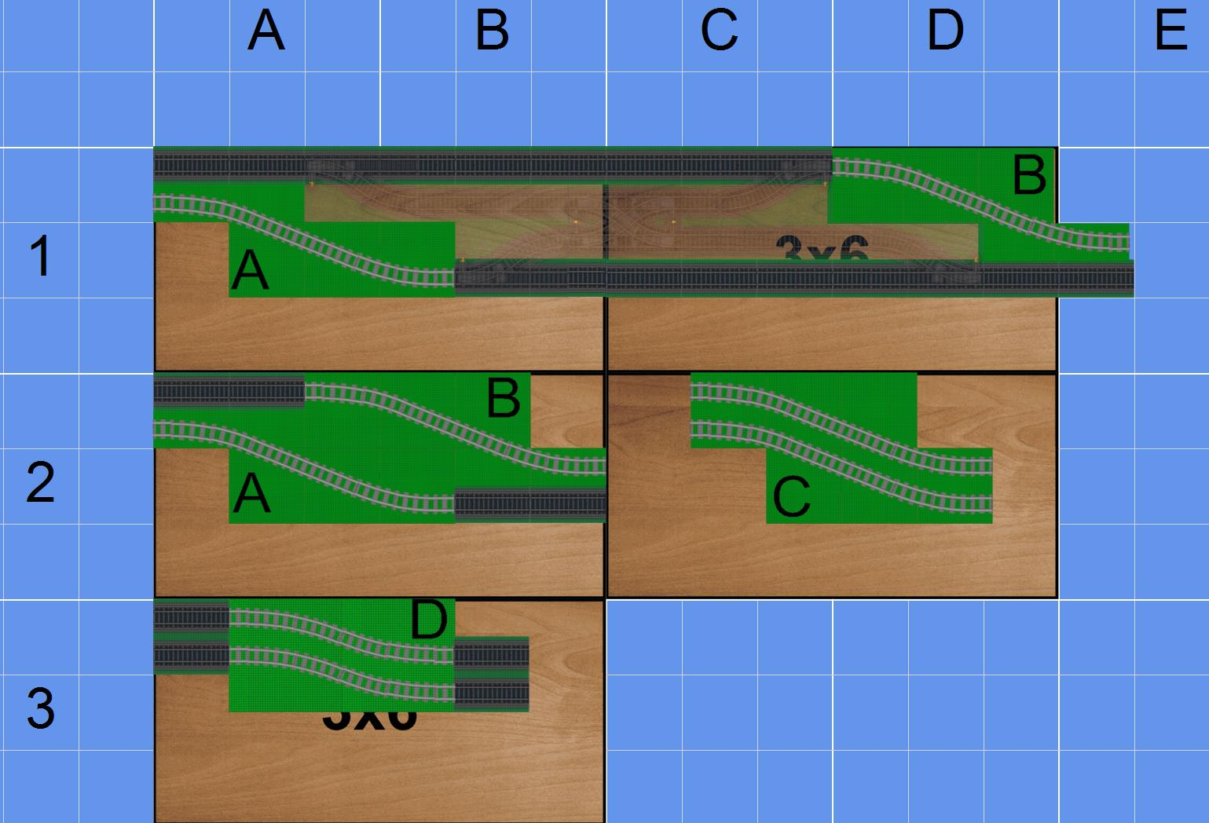
S Curves
2 R88 curves
3 straights
2 R88 curves
R104 S Curves
Doesn’t line up 100%

Slide 20
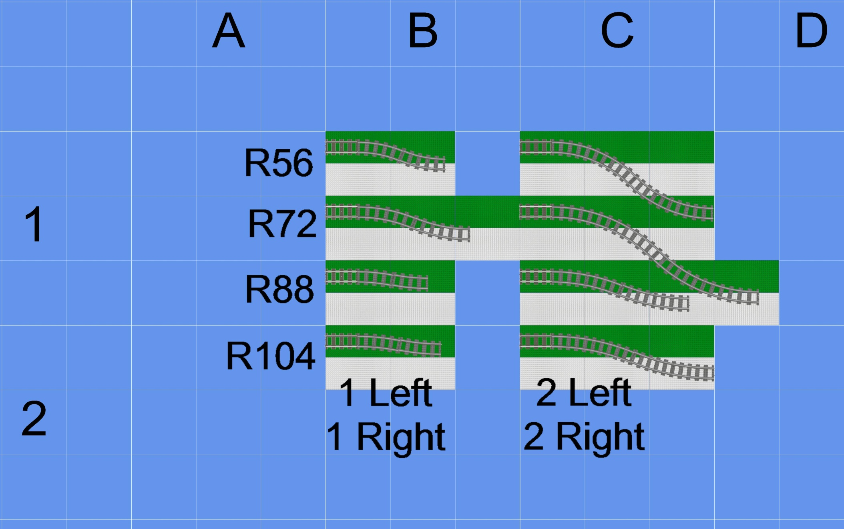
S Curves

Slide 21
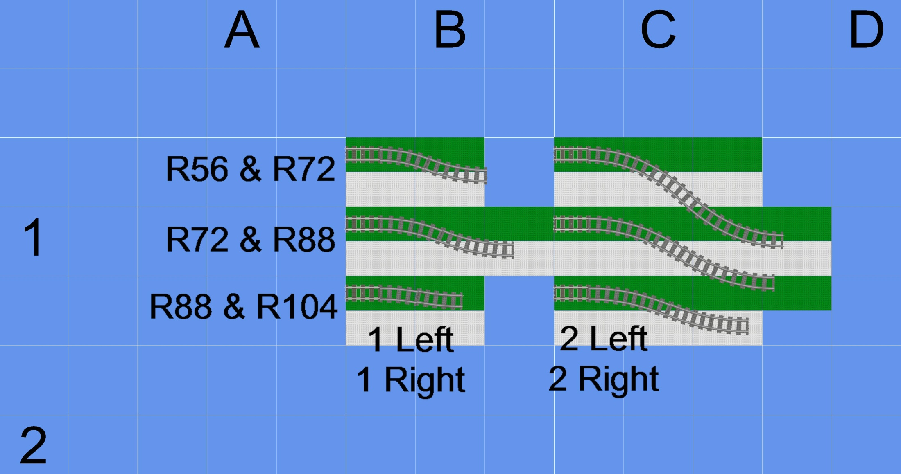
S Curves

Slide 22
Ballasting Track
Why ballast?
Looks awesome.
Prevents track from shifting
Helps level track
There is no one right way to ballast track
TBRR uses the PennLUG style, which was based on another LUG’s design, which was based on another LUG’s design, which was based on…

Slide 23
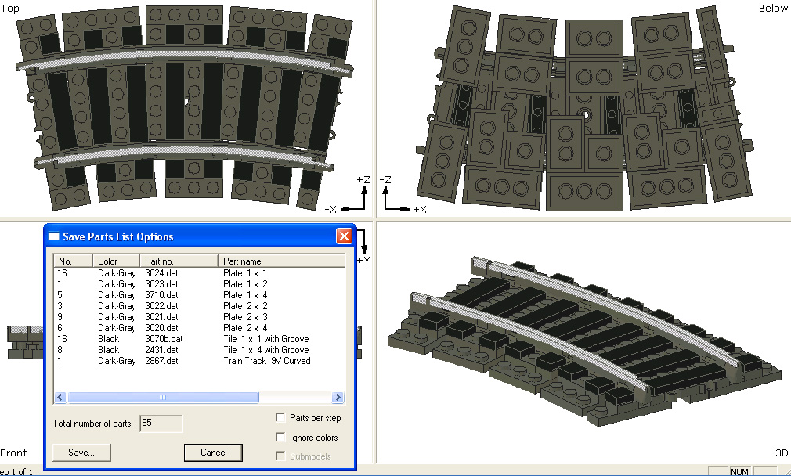
Ballasting ME Models Curves
Ballasting straight track is the same as LEGO
Ballasting any curved track is difficult

Slide 24
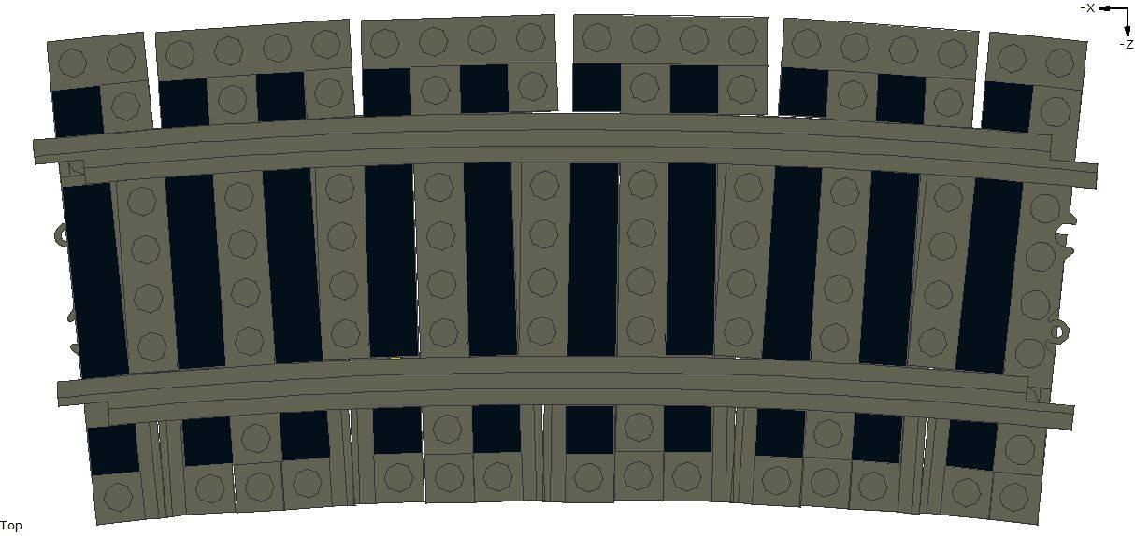
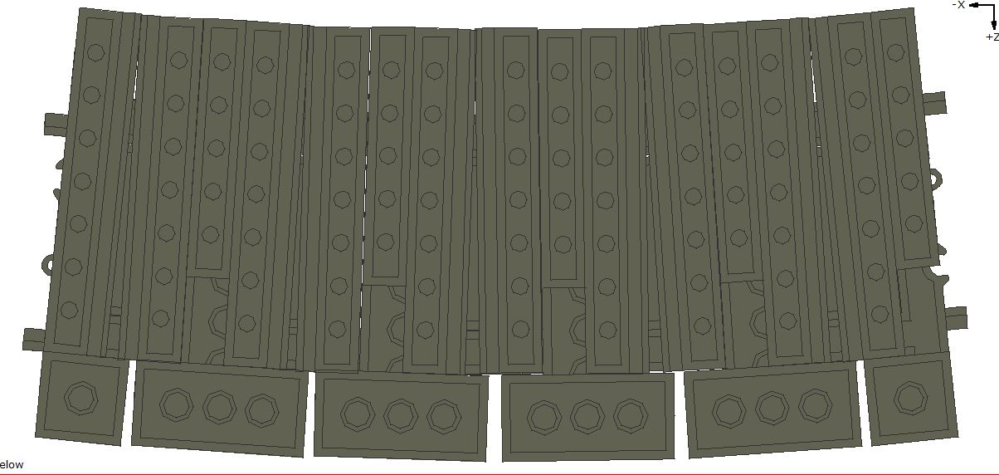
R104

Slide 25
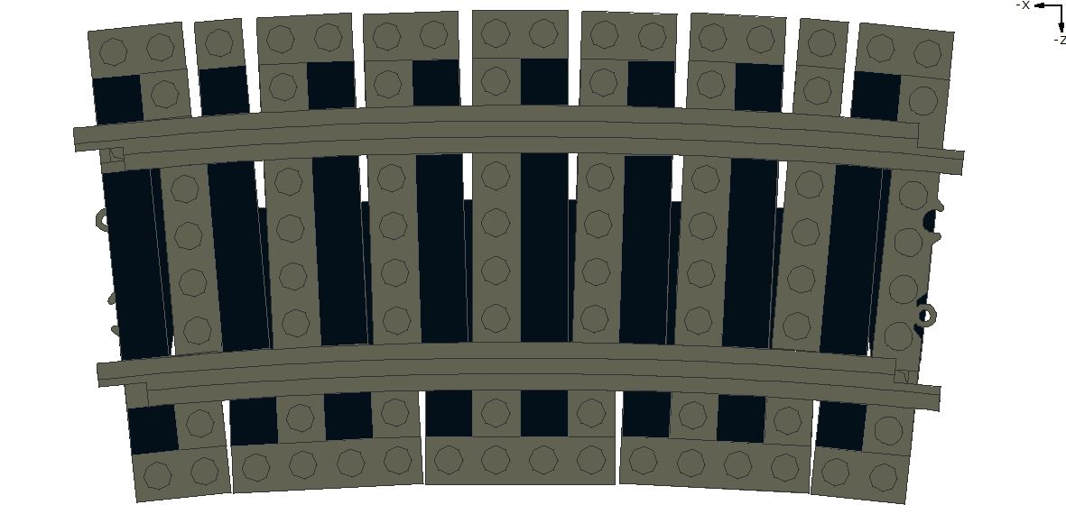
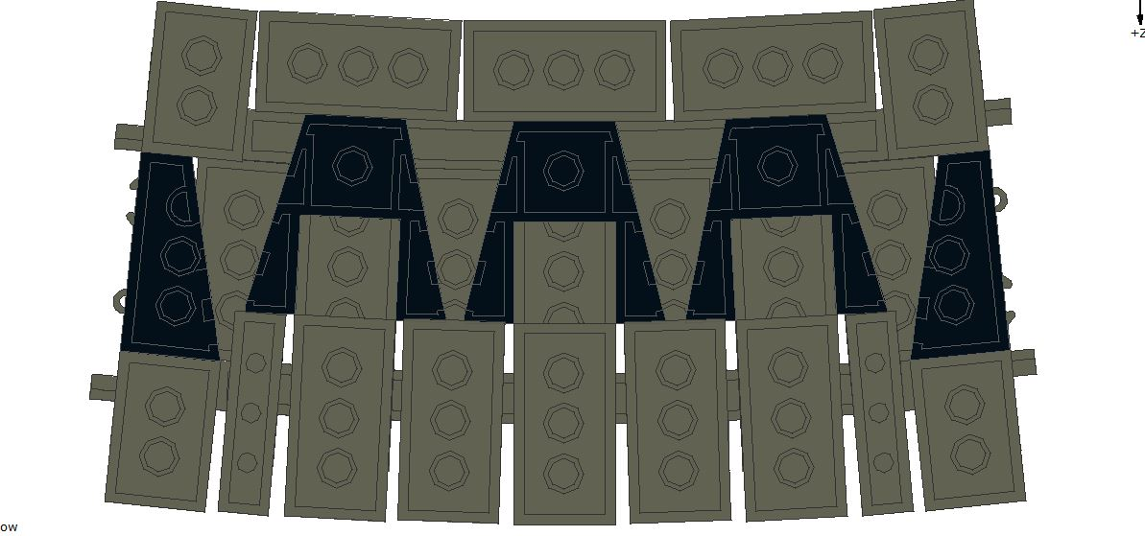
R88

Slide 26
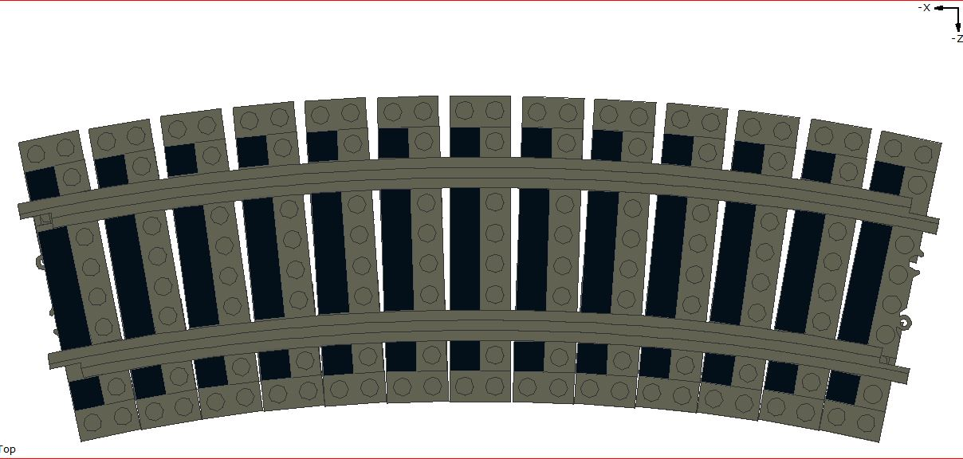
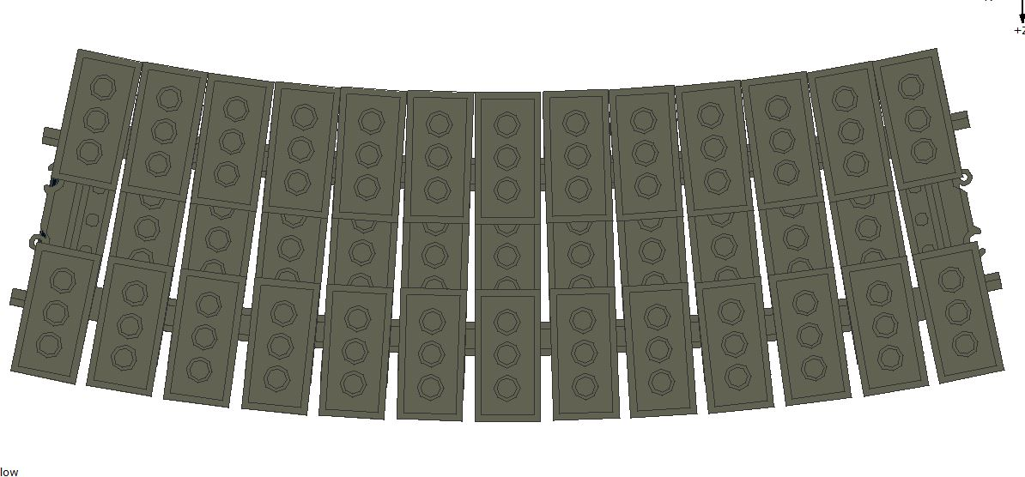
R72

Slide 27
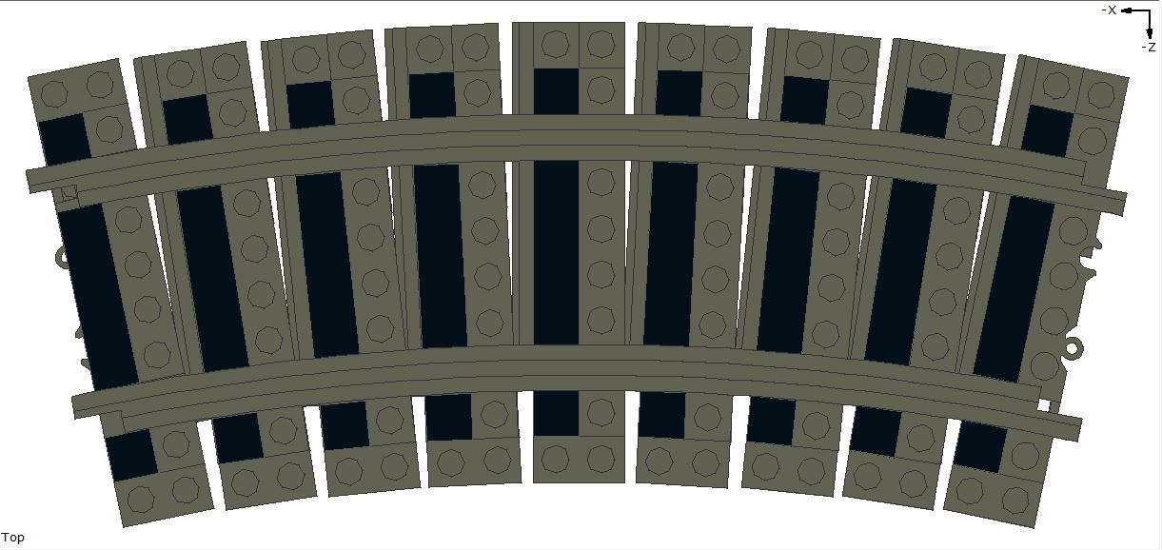
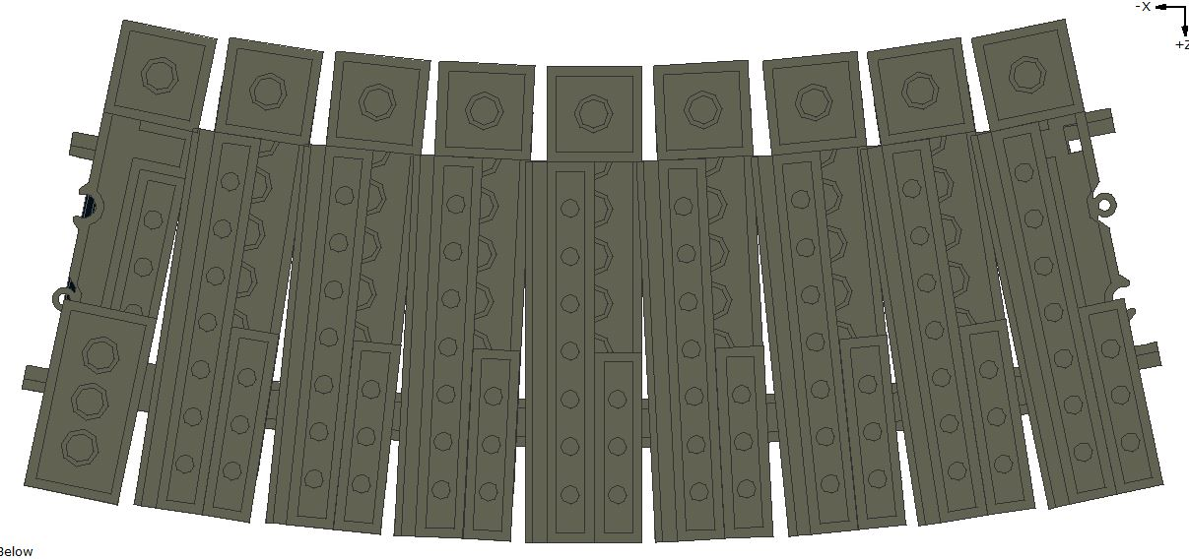
R56

Slide 28
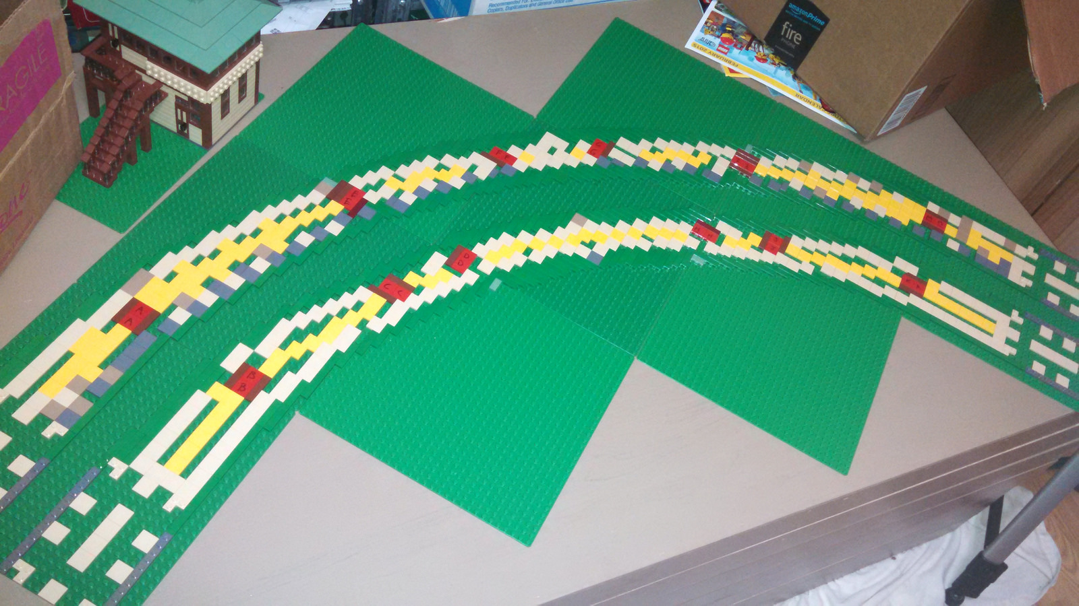
A proper foundation

Slide 29
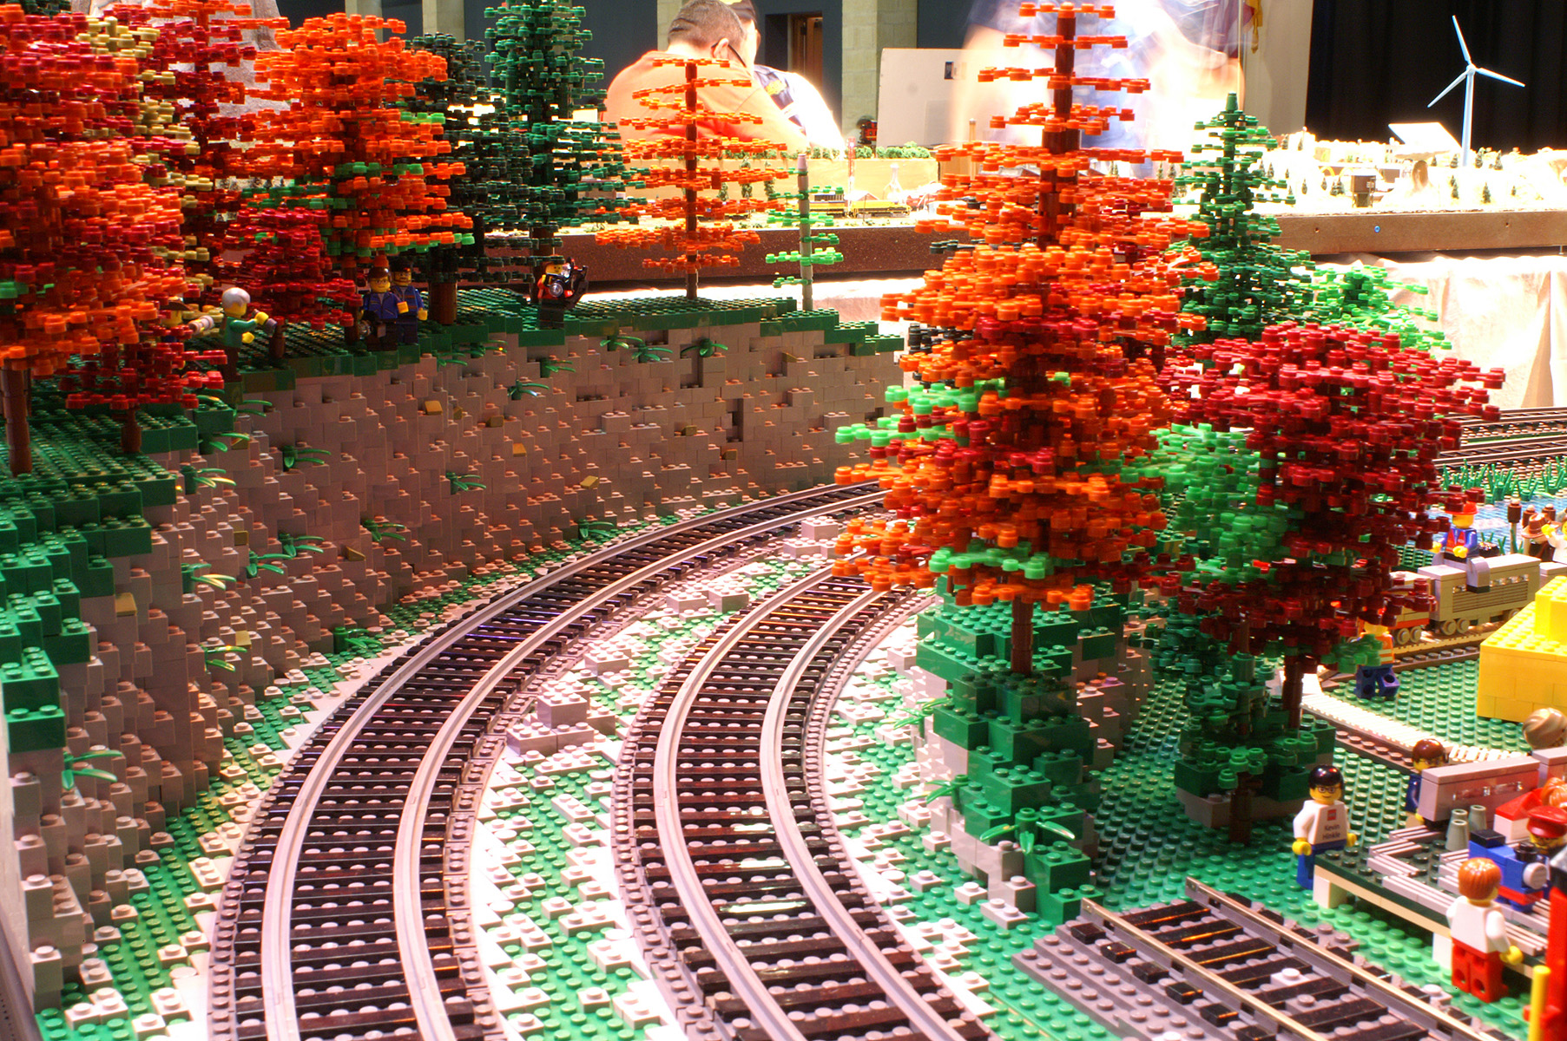
Finally Installed

Slide 30
Modeling with ME Models Rails
Questions?
Asking a question gets another ticket!
More tickets, better chance of winning!
Door Prize drawing!
(one prize per person, please)

